Slide 1
Climate Change Belief Analysis
Presentation by
NATURE INC

Slide 2

NATURE INC
MISSION
To drive our client’s data-centered projects to achieve their business strategies on improved service delivery and customer satisfaction.
CORE VALUES
Sustainability
Timely
Original
Resourcefulness
Mastery

Slide 3
Meet Our Eco Team
COLIN
OGAGA
GATHONI
FAITH
MICHEAL
About me
About me
About me
About me
About me

Slide 4
Presentation Outline
1
5
3
Introduction
Exploratory Data Analysis
Modelling
2
4
Problem Statement
Feature Engineering
7
Conclusion
6
8
Model
Deployment
Limitation

Slide 5
1
Introduction
What is Global warming?
What are the effects of Global warming on the environment?
What is the government and Industry doing about it?
What are the beliefs about Climate Change?

Slide 6

2
Problem Statement
To develop an ML model to categorize twitter users into sentiments based on the content of their tweets (Vision)
How do customers, businesses and government reacts to the impacts of Climate Change? (Issue)
Use a Classification technique to a ML model to differentiate twitter user’s sentiments. (Process)

Slide 7

Exploratory Data Analysis
3
Check for Null Values
Number of Observed data
Graphs and Word Clouds
There were 3000 observed data by rows.

Slide 8
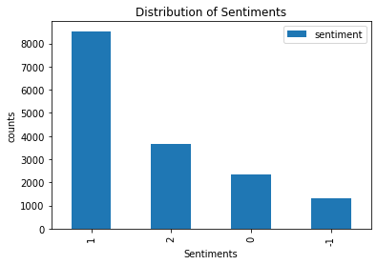
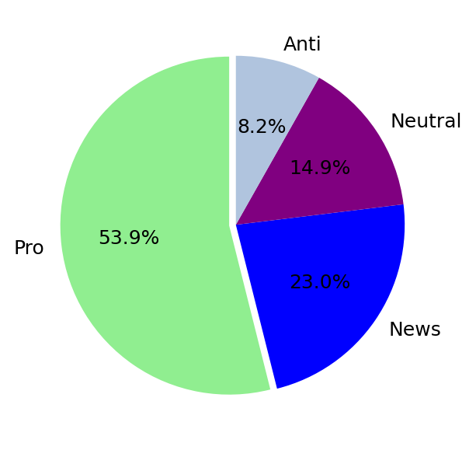
Exploratory Data Analysis
Graphs showing data imbalance
Key: 1- Pro Sentiments, 2- New Sentiments, 0- Neutral Sentiments, -1- Anti Sentiments

Slide 9
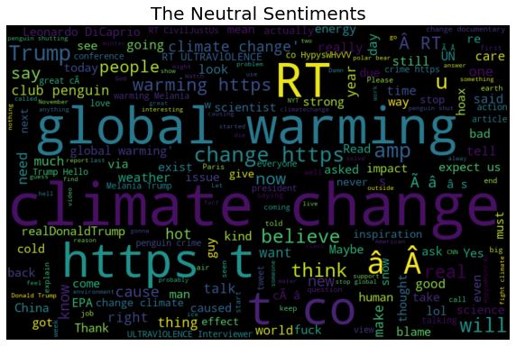
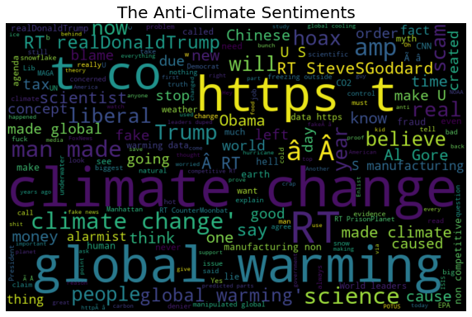
Exploratory Data Analysis

Slide 10
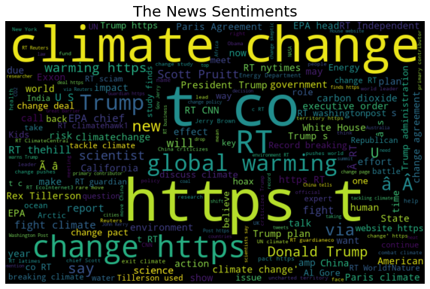
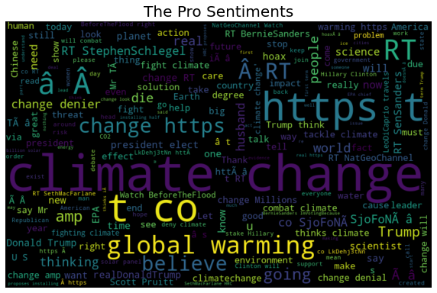
Exploratory Data Analysis

Slide 11

4
Feature Engineering
Data Cleaning
Feature Extraction
Data Class
Balancing

Slide 12
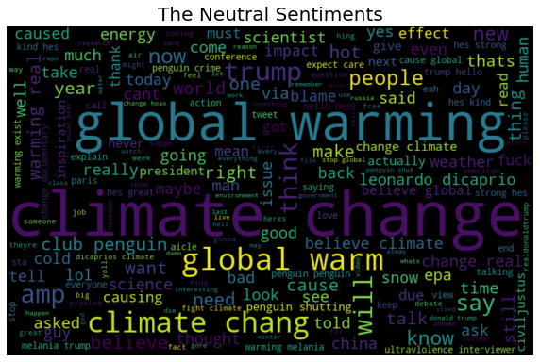
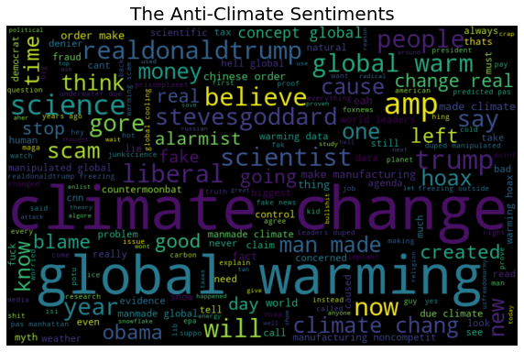
Feature Engineering

Slide 13
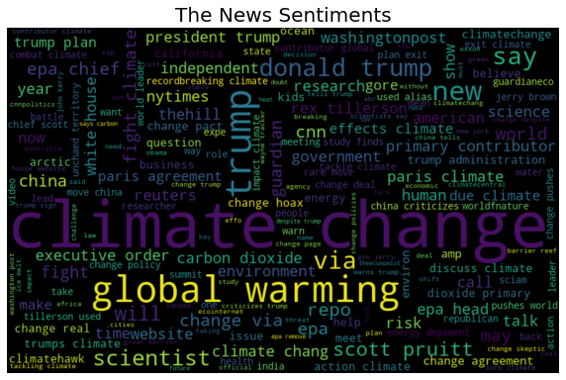
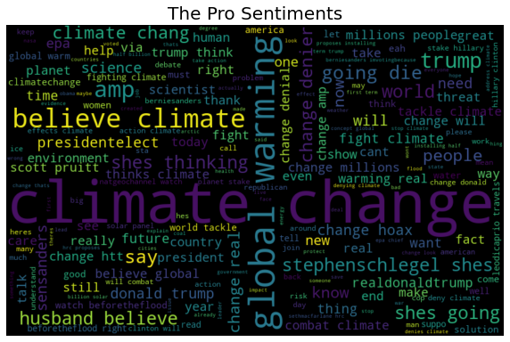
Feature Engineering

Slide 14
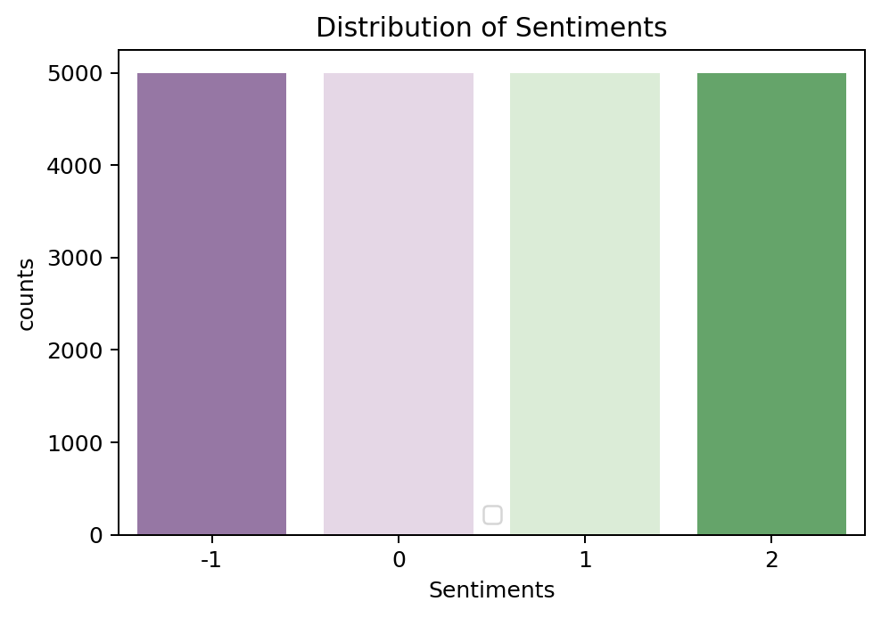
Balanced Classes

Slide 15

Modelling
5
Model Building
Logistic Regression
Multinomial Naive Bayes
BaggingClassifier
Random Forest

Slide 16
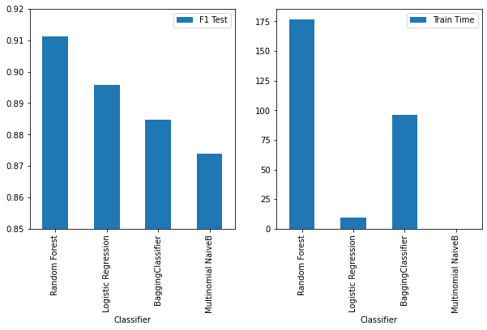
Model Performance Assessment
F1_Score

Slide 17
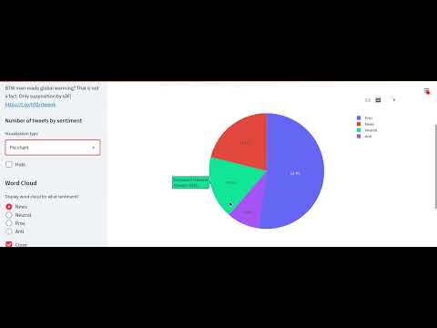
6
Model Deployment
Stream Cast- Juju Classifier

Slide 18
Conclusions
7
The Logistic regression model performed best when exposed to unseen data.
Based on the model performance, companies and stakeholders can understand how people perceive climate change and whether or not they believe it’s a threat.

Slide 19
Limitation
8
From observation dataset was captured from the United State of America region and as such not a global opinion

Slide 20

Thank
you!

